Slide 1


Slide 2

ESSAY wRITING
Notes:
NOTE:
To change the image on this slide, select the picture and delete it. Then click the Pictures icon in the placeholder to insert your own image.

Slide 3
Presented By
Muhammad Umer (005)

Slide 4
Introduction
An essay is a short piece of writing where someone shares their ideas, thoughts, or opinions about a specific topic. It usually has an introduction to explain what the essay is about, a middle part with details and examples, and a conclusion to wrap things up. Essays help people express what they think clearly and in an organized way.

Slide 5
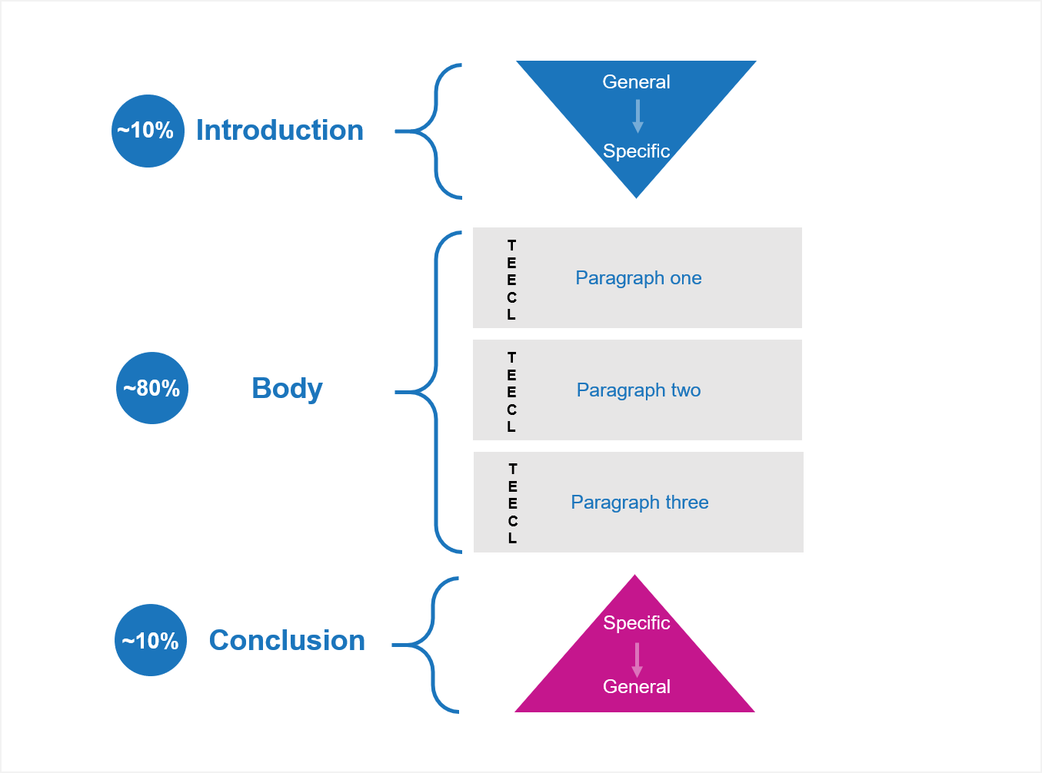
Structure of Essay
Introduction
Main Body
Conclusion

Slide 6
Types of an Essay
1
Descriptive
Essay
2
Compare and Contrast Essay
3
Narrative Essay
4
Discursive Essay
5
Argumentative Essay

Slide 7
Descriptive Essay
A descriptive essay is a type of writing that explains or describes something in a way that helps the reader imagine it clearly. It can be about a person, place, object, event, or even a feeling, using detailed words that appeal to the senses like sight, sound, smell, taste, and touch. The goal is to paint a picture with words so the reader can feel like they are experiencing it too.
A Rainy Day in the City
My Grandmother’s Kitchen

Slide 8
Compare and Contrast Essay
A compare and contrast essay is a type of writing where you look at two or more things to show how they are alike (compare) and how they are different (contrast). The goal is to help the reader understand the similarities and differences between the subjects. This kind of essay often uses clear points and examples to make the comparison easy to follow.
City life VS Village life
Online classes VS Traditional classroom classes

Slide 9
Narrative Essay
A narrative essay is a type of writing that tells a story about a real or imagined event from the writer’s life or someone else’s. It has characters, a setting, a plot, and usually a clear beginning, middle, and end. The goal is to share an experience in a way that feels interesting and meaningful to the reader.
The day I got lost at the fair
My first time on an Airplane.

Slide 10
Discursive Essay
A discursive essay is a type of writing that explores a topic by presenting different sides of an argument in a fair and balanced way. It explains both the supporting and opposing views clearly, helping the reader think deeply and form their own opinion.
Should Social Media be regulated more strictly
Is homework beneficial for students

Slide 11
Argumentative Essay
An argumentative essay is a type of writing where the writer takes a strong stance on a specific issue and tries to convince the reader to agree with that viewpoint. It presents clear arguments, supports them with evidence like facts, examples, or research, and often addresses opposing views to show why the writer’s opinion is stronger.
School uniform should be mandatory
Social Media does more harm than good

Slide 12

Thesis Statement
Introduction
Body Paragraphs
Coherence and Flow
Supporting Details
Conclusion
Language and Grammar
Originality
Good Essay

Slide 13
Thank You

